Slide 1

Predicting MLB Player Performance
Mike Ogrysko
December 2022

Slide 2

Project Background
MLB nearing $11 billion in gross revenues in 2022 (Brown, 2022)
Average value of a team is $2 billion (Ozanian & Teitelbaum, 2022)
Team payrolls range from $61 million to $282 million (Spotrac, 2022)
Reliance on data and analytics for on-field product
Teams generate metrics to project player performance to create rosters

Slide 3

Research Questions
What is the estimated peak player age at each position?
Of the players who are playing at their estimated peak age in 2023, which will exceed their 2022 Wins Above Replacement (WAR) metric?
Of the players who played at their peak age in 2022, which will exceed their 2022 WAR metric?
How will these players perform in 2023?

Slide 4

Sources and Nature of Data
MLB player data is publicly available
Stathead Baseball (https://stathead.com/baseball)
Full batting, pitching, and fielding statistics and play-by-play data from 1976 to present
Focus on player data from 1980 onwards
WAR metric used to measure player performance
What is WAR?
Wins Above Replacement (WAR)
Number of team wins that a player represents when compared to a replacement player at the same position
Example:
Team of only minor league players estimated to win 48 games
Player from the team replaced with a free agent and team wins jump to 54
New player’s WAR is 6
A Fan’s Guide to Baseball Analytics (pp. 189-191) by A. Castrovince, 2020.

Slide 5

Tools and Methods
Estimating Peak Age at Each Position
Analysis of career-best player seasons (according to WAR metric) to determine age with highest frequency
Exceeding Previous WAR Metrics in 2023
Binary classification using Support Vector Machines (SVM) algorithm – 0 does not exceed, 1 exceeds
Predicting Player Performance in 2023
WAR classification using Random Forest algorithm – 0 to 6 using the categorization
WAR prediction using Multiple Linear Regression model
WAR Categorization
A Fan’s Guide to Baseball Analytics (p. 192) by A. Castrovince, 2020.
Quality of Player | WAR
MVP Material | 8 or higher
Superstar | 6-8
All-Star | 4-6
Solid Regular | 2-4
Role Player | 1-2
Bench Material | 0-1
Triple A Material | 0 or below

Slide 6

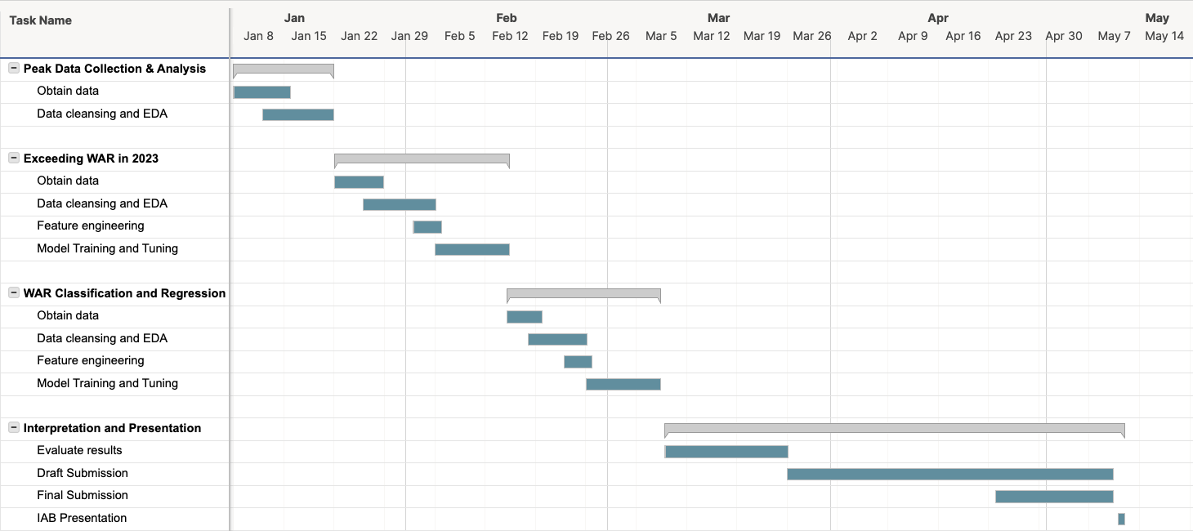
Project Plan

Slide 7

Assumptions and Risks
Data from Stathead Baseball is sufficient for analysis – will additional data be necessary from other sources?
Currently identified models will be sufficient to answer the research questions – will alternative models be needed to achieve the desired results?
Scope creep – will additional questions be introduced that need to be answered in this analysis?
Data availability risks should be low since player data is publicly available

Slide 8

Thank you!

Slide 9

References
Brown, M. (2022, Apr 7). How Major League Baseball could crack $11 billion in revenues in 2022. Forbes. https://www.forbes.com/sites/maurybrown/2022/04/07/how-major-league- baseball-could-crack-11-billion-in-revenues-in-2022/?sh=68098b77f63a
Castrovince, A. (2020). A fan’s guide to baseball analytics. Sports Publishing.
Ozanian, M. & Teitelbaum, J. (2022, Mar 24). Baseball’s most valuable teams 2022: Yankees hit $6 billion as new CBA creates new revenue streams. Forbes. https://www.forbes.com/sites/mikeozanian/2022/03/24/baseballs-most-valuable-teams- 2022-yankees-hit-6-billion-as-new-cba-creates-new-revenue-streams/?sh=244684d600a2
Spotrac. (2022). MLB team payroll tracker. https://www.spotrac.com/mlb/payroll/2022/?ref=trending-pages
Presentation images: Getty Images/Ringer illustration

